Slide 1
MALCOM Machine Learning for Communication Systems Lecture 2 Recap – Review Key concepts from Neural Networks Omid Esrafilian Spring 2024

Slide 2
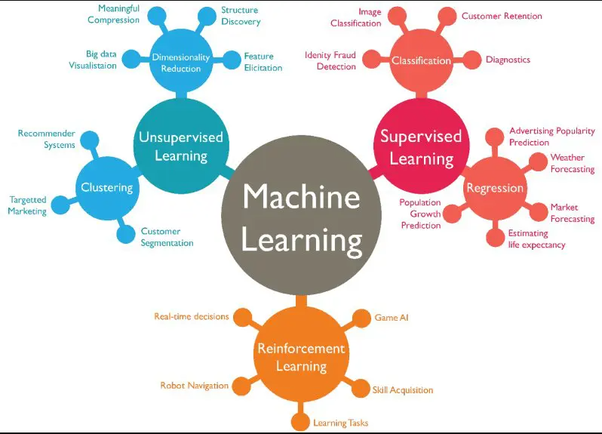
Machine Learning
Notes:
Ajouter une photo d’un vieux telegraphe, puis un mobile satellitte ancienne generation…can someone find an even older wireless communication system (smoke)

Slide 3
Linear Classification
Notes:
Ajouter une photo d’un vieux telegraphe, puis un mobile satellitte ancienne generation…can someone find an even older wireless communication system (smoke)

Slide 4
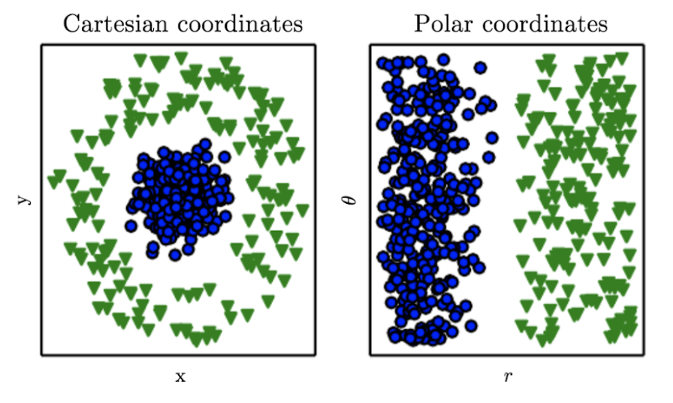
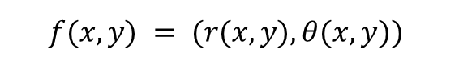
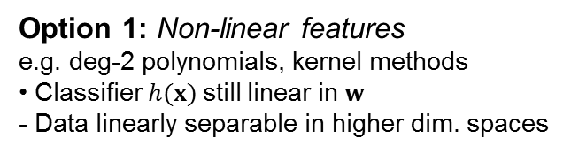
Non Linearly Separable Data
Option 1: Non-linear features
e.g. deg-2 polynomials, kernel methods
• Classifier $h(x)$still linear in $w$
- Data linearly separable in higher dim. spaces
$$f(x, y) = (r(x, y), θ(x, y))$$
https://www.deeplearningbook.org/contents/intro.html
Notes:
Ajouter une photo d’un vieux telegraphe, puis un mobile satellitte ancienne generation…can someone find an even older wireless communication system (smoke)

Slide 5
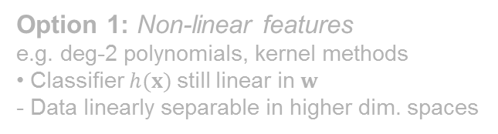
Non Linearly Separable Data
Option 1: Non-linear features
e.g. deg-2 polynomials, kernel methods
• Classifier $h(x)$still linear in $w$
- Data linearly separable in higher dim. spaces
Option 2: Non-linear classifiers
e.g. decision trees, neural networks,…
More general but harder to learn
(non-convex optimization)
Use the joint decision of several linear classifiers?
Notes:
Ajouter une photo d’un vieux telegraphe, puis un mobile satellitte ancienne generation…can someone find an even older wireless communication system (smoke)

Slide 6
Combining Models
1. Evaluate each model
2. Combine the outputs of models
Neural Network
Perceptron / Neuron
Notes:
Ajouter une photo d’un vieux telegraphe, puis un mobile satellitte ancienne generation…can someone find an even older wireless communication system (smoke)

Slide 7
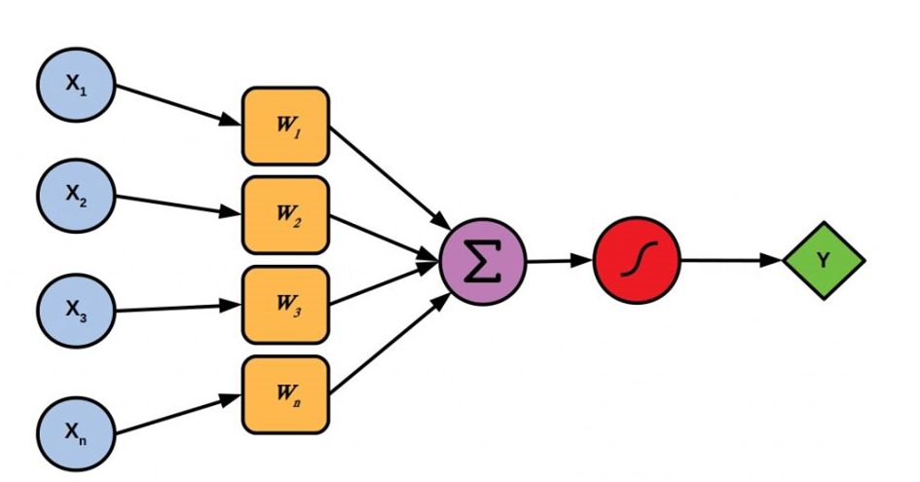
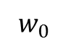
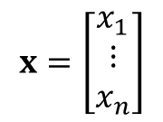
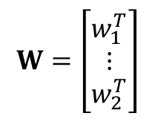

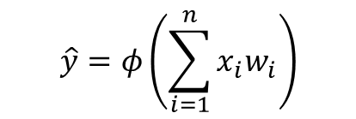
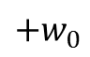
Perceptron: Forward Pass
1
$$w_{0}$$
$${+w}_{0}$$
$$\hat{y}=φ\left(\sum_{i=1}^{n}{x_{i}w_{i}}\right)$$
$$\hat{y}=φ\left(Wx\right)$$
$$W=\left[\begin{aligned}w_{1}^{T} \\ ⋮ \\ w_{2}^{T}\end{aligned}\right]$$
$$x=\left[\begin{aligned}x_{1} \\ \begin{aligned}⋮ \\ x_{n}\end{aligned}\end{aligned}\right]$$
Inputs
Weights
Sum
Non-linearity
Output
Notes:
Ajouter une photo d’un vieux telegraphe, puis un mobile satellitte ancienne generation…can someone find an even older wireless communication system (smoke)

Slide 8
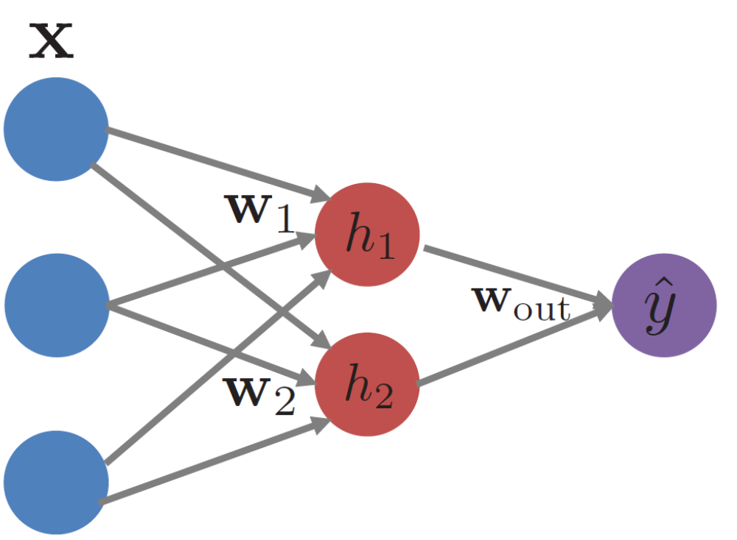
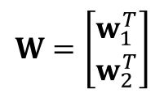
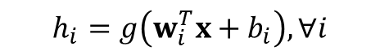
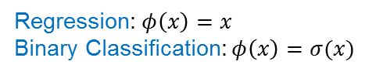
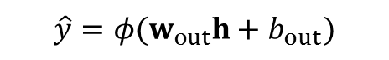
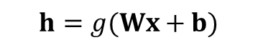
Feedforward Neural Networks
Input data (input units)
Hidden units
Output unit
$$\hat{y}=φ(w_{out}h+b_{out})$$
$$h_{i}=g\left(w_{i}^{T}x+b_{i}\right), ∀i$$
Activation function on the output depends on the task
$$W=\left[\begin{aligned}w_{1}^{T} \\ w_{2}^{T}\end{aligned}\right]$$
Regression: $φ\left(x\right)=x$
Binary Classification: $φ\left(x\right)=σ(x)$
$$h=g(Wx+b)$$
Notes:
Ajouter une photo d’un vieux telegraphe, puis un mobile satellitte ancienne generation…can someone find an even older wireless communication system (smoke)

Slide 9

Feedforward Neural Networks
Possible to have multiple output units
(e.g. multi-label classification)
Possible to stack more than one hidden layer (depth)
$h^{(1)}=σ(W^{(1)}x+b^{(1)})→h^{(2)}=σ(W^{(2)}h^{(1)}+b^{(2)})$ $→\hat{y}=φ(w_{out}h^{(2)}+b_{out})$
$$h^{(i)}=φ_{i}(W^{(i)}h^{(i−1)}+b^{(i)})$$
Notes:
Ajouter une photo d’un vieux telegraphe, puis un mobile satellitte ancienne generation…can someone find an even older wireless communication system (smoke)

Slide 10


Neural Networks Architectures
Collections of neurons that are connected in an acyclic graph (Feedforward)
Cycles are not allowed since that would imply an infinite loop in the forward pass of a network
2-layer NN or 1-hidden layer NN
3-layer NN
Input layer does not count
single-layer neural network describes a network with no hidden layers (input directly mapped to output)
4 + 2 = 6 neurons
[3 x 4] + [4 x 2] = 20 weights
4 + 2 = 6 biases
Total of 26 learnable parameters.
4 + 4 + 1 = 9 neurons
[3 x 4] + [4 x 4] + [4 x 1] = 12 + 16 + 4 = 32 weights
4 + 4 + 1 = 9 biases
Total of 41 learnable parameters.
Notes:
Ajouter une photo d’un vieux telegraphe, puis un mobile satellitte ancienne generation…can someone find an even older wireless communication system (smoke)

Slide 11
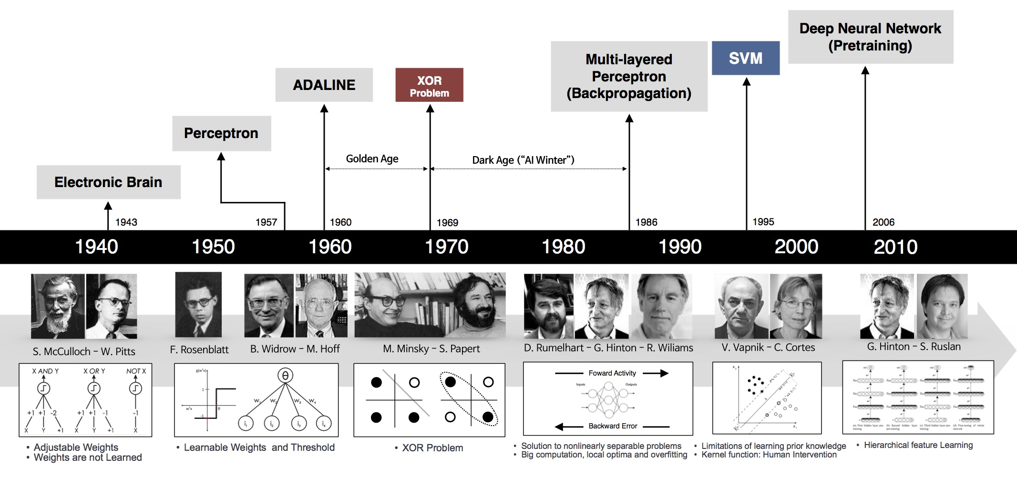
History of Neural Networks
Source: http://beamlab.org/deeplearning/2017/02/23/deep_learning_101_part1.html
Notes:
Ajouter une photo d’un vieux telegraphe, puis un mobile satellitte ancienne generation…can someone find an even older wireless communication system (smoke)

Slide 12
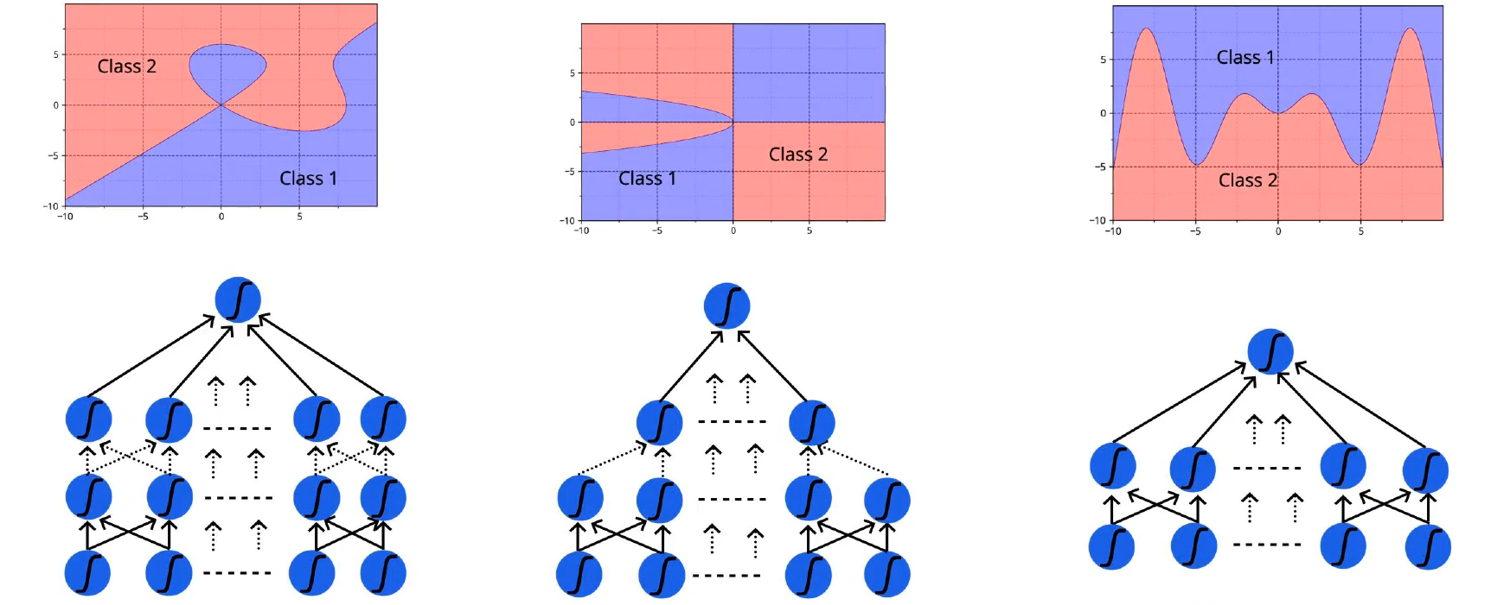
Power of Neural Networks
Universal Approximation Theorem [Cybenko’89, Hornik’91]
A feedforward network with a single layer is sufficient to approximate, to an arbitrary precision, any continuous function
Source: https://medium.com/hackernoon/illustrative-proof-of-universal-approximation-theorem-5845c02822f6
Caveats
The number of hidden units may be infeasibly large
The resulting model may not generalize
Notes:
Ajouter une photo d’un vieux telegraphe, puis un mobile satellitte ancienne generation…can someone find an even older wireless communication system (smoke)

Slide 13

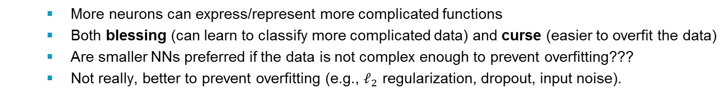
Neural Networks: Size and Depth
The capacity of a NN increases, as we increase the size (hidden units) and number of hidden layers.
A binary classification problem in two dimensions. Larger NNs can represent more complicated functions.
Data is shown as circles colored by their class - decision regions obtained by a trained neural network
More neurons can express/represent more complicated functions
Both blessing (can learn to classify more complicated data) and curse (easier to overfit the data)
Are smaller NNs preferred if the data is not complex enough to prevent overfitting???
Not really, better to prevent overfitting (e.g., $ℓ_{2}$ regularization, dropout, input noise).
Notes:
Ajouter une photo d’un vieux telegraphe, puis un mobile satellitte ancienne generation…can someone find an even older wireless communication system (smoke)

Slide 14
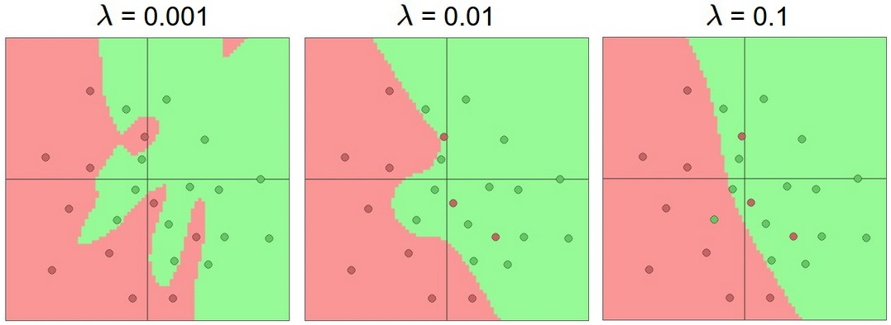
Neural Networks: Control overfitting vs. size
NN with 20 hidden neurons, but variable regularization strength: its final decision regions smoother with a higher regularization.
Smaller NNs are harder to train with local methods (e.g. Gradient Descent)
Their loss functions have relatively few local minima, but it turns out that many of these minima are easier to converge to, and that they are bad (i.e. with high loss).
Bigger NNs contain significantly more local minima, but these minima turn out to be much better in terms of their actual loss.
In practice:
Small network: final loss can display a good amount of variance (sometimes lucky - converge to a good place, but in some cases trapped in one of the bad minima).
Large network: start to find many different solutions, but the variance in the final achieved loss will be much smaller. In other words, all solutions are about equally as good, and rely less on the luck of random initialization.
Takeaway: use as big of a NN as your computational budget allows, and use other regularization techniques to control overfitting.
Notes:
Ajouter une photo d’un vieux telegraphe, puis un mobile satellitte ancienne generation…can someone find an even older wireless communication system (smoke)

Slide 15
Network Architecture
Architecture is the overall structure of the network
feed-forward network (multilayer perceptron)
can have many layers
# layers is called the depth of the network
each layer can be fully connected (dense) or sparse
layers may have skip layer connections
helps with gradient flow
units may have different activations
parameters may be shared across units (e.g., in CNNs)
more generally a directed acyclic graph (DAG) expresses the feed-forward architecture
Notes:
Ajouter une photo d’un vieux telegraphe, puis un mobile satellitte ancienne generation…can someone find an even older wireless communication system (smoke)

Slide 16
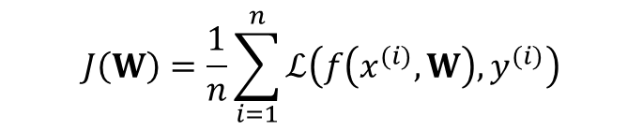
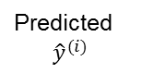
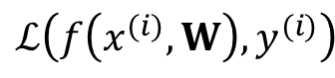
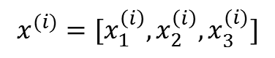
Loss
Loss function: a function to measure the goodness of the predictions (network performance)
Choice of the loss function depends on the concrete problem or the distribution of the target variable
$$x^{(i)}=[x_{1}^{\left(i\right)},x_{2}^{\left(i\right)},x_{3}^{(i)}]$$
The loss of our network measures the cost incurred from incorrect predictions
Empirical risk
Cost function
Objective function
The empirical loss measures the total loss over the entire dataset
$$ℒ\left(f\left(x^{(i)},W\right),y^{(i)}\right)$$
$$J\left(W\right)=\frac{1}{n}\sum_{i=1}^{n}{ℒ\left(f\left(x^{(i)},W\right),y^{(i)}\right)}$$
Predicted
$${\hat{y}}^{(i)}$$
Actual
Notes:
Ajouter une photo d’un vieux telegraphe, puis un mobile satellitte ancienne generation…can someone find an even older wireless communication system (smoke)

Slide 17
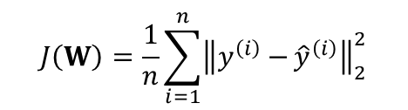
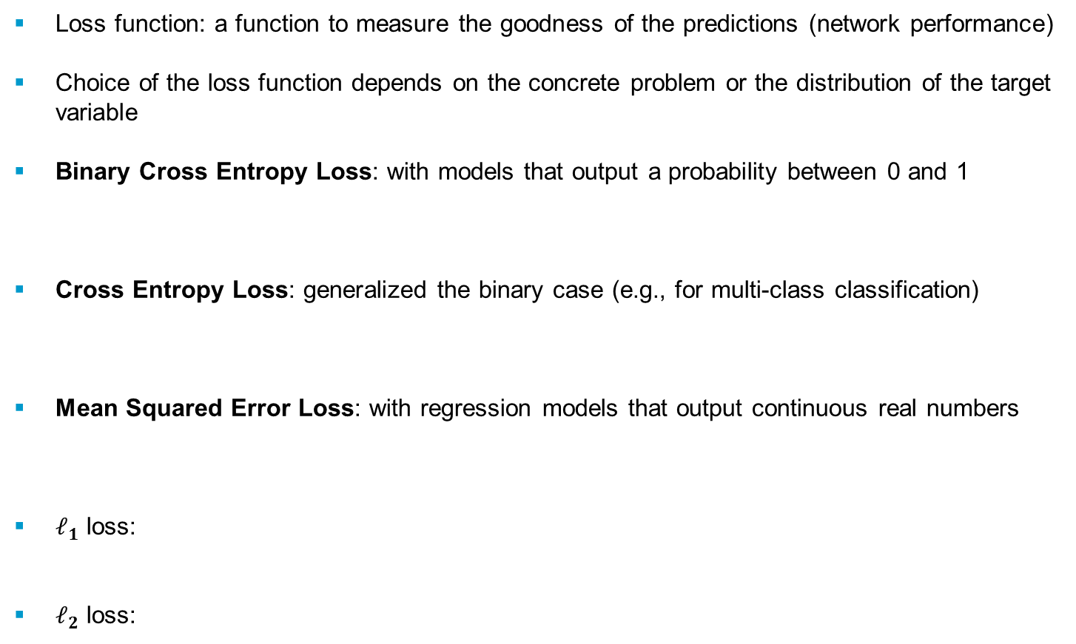
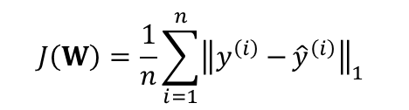


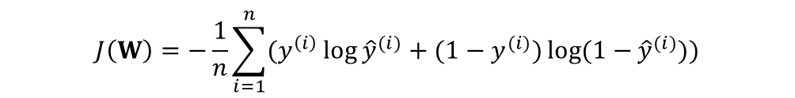
Loss Functions
Loss function: a function to measure the goodness of the predictions (network performance)
Choice of the loss function depends on the concrete problem or the distribution of the target variable
Binary Cross Entropy Loss: with models that output a probability between 0 and 1
Cross Entropy Loss: generalized the binary case (e.g., for multi-class classification)
Mean Squared Error Loss: with regression models that output continuous real numbers
$ℓ_{1}$ loss:
$ℓ_{2}$ loss:
$$J\left(W\right)=−\frac{1}{n}\sum_{i=1}^{n}{(y^{\left(i\right)}\log{{\hat{y}}^{(i)}}+(1−y^{(i)})log⁡(1−{{\hat{y}}^{(i)})})}$$
$$J\left(W\right)=−\frac{1}{n}\sum_{i=1}^{n}{\sum_{k=1}^{k}{(y^{\left(i,k\right)}\log{{\hat{y}}^{\left(i,k\right)}})}}$$
$$J\left(W\right)=\frac{1}{n}\sum_{i=1}^{n}{{(y^{\left(i\right)}−{{\hat{y}}^{\left(i\right)}})}^{2} }$$
$$J\left(W\right)=\frac{1}{n}\sum_{i=1}^{n}{{\left\|y^{\left(i\right)}−{{\hat{y}}^{\left(i\right)}}\right\|}_{1} }$$
$$J\left(W\right)=\frac{1}{n}\sum_{i=1}^{n}{{\left\|y^{\left(i\right)}−{{\hat{y}}^{\left(i\right)}}\right\|}_{2}^{2}}$$
Notes:
Ajouter une photo d’un vieux telegraphe, puis un mobile satellitte ancienne generation…can someone find an even older wireless communication system (smoke)

Slide 18
Computational Graphs
Directional graph
Matrix operations are represented as compute nodes.
Vertex nodes are variables or operators like +, --, *, /, log(), exp() …
Directional edges show flow of inputs to vertices
Notes:
Ajouter une photo d’un vieux telegraphe, puis un mobile satellitte ancienne generation…can someone find an even older wireless communication system (smoke)

Slide 19
Computational Graphs
Directional graph
Matrix operations are represented as compute nodes.
Vertex nodes are variables or operators like +, --, *, /, log(), exp() …
Directional edges show flow of inputs to vertices
Notes:
Ajouter une photo d’un vieux telegraphe, puis un mobile satellitte ancienne generation…can someone find an even older wireless communication system (smoke)

Slide 20
Computational Graphs
A neural network can be represented as a computational graph...
it has compute nodes (operations)
it has edges that connect nodes (data flow)
it is directional
it can be organized into ‘layers’
Notes:
Ajouter une photo d’un vieux telegraphe, puis un mobile satellitte ancienne generation…can someone find an even older wireless communication system (smoke)

Slide 21
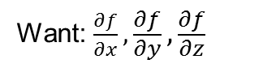
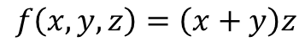
Computing Gradients: Backpropagation
Neural nets will be very large: impractical to write down gradient formula by hand for all parameters
Backpropagation = recursive application of the chain rule along a computational graph to compute the gradients of all inputs/parameters/intermediates
Forward: compute result of an operation and save any intermediates needed for gradient computation in memory
Backward: apply the chain rule to compute the gradient of the loss function with respect to the inputs
A simple example
$$f\left(x,y,z\right)=\left(x+y\right)z$$
Want: $\frac{∂f}{∂x},\frac{∂f}{∂y},\frac{∂f}{∂z}$
On the whiteboard …
Notes:
Ajouter une photo d’un vieux telegraphe, puis un mobile satellitte ancienne generation…can someone find an even older wireless communication system (smoke)

Slide 22
The Flow of the Gradients
Notes:
Ajouter une photo d’un vieux telegraphe, puis un mobile satellitte ancienne generation…can someone find an even older wireless communication system (smoke)

Slide 23
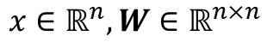
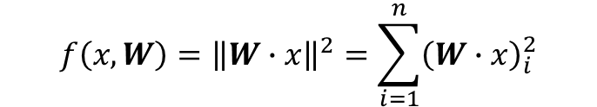
Backpropagation
$$f\left(x,W\right)={\left\|W∙x\right\|}^{2}=\sum_{i=1}^{n}{{\left(W∙x\right)}_{i}^{2}}$$
A vectorized example
$$x∈ℝ^{n}, W∈ℝ^{n×n}$$
Notes:
Ajouter une photo d’un vieux telegraphe, puis un mobile satellitte ancienne generation…can someone find an even older wireless communication system (smoke)

Slide 24
Backpropagation
$$f\left(x,W\right)={\left\|W∙x\right\|}^{2}=\sum_{i=1}^{n}{{\left(W∙x\right)}_{i}^{2}}$$
A vectorized example
Notes:
Ajouter une photo d’un vieux telegraphe, puis un mobile satellitte ancienne generation…can someone find an even older wireless communication system (smoke)

Slide 25
Backpropagation
$$f\left(x,W\right)={\left\|W∙x\right\|}^{2}=\sum_{i=1}^{n}{{\left(W∙x\right)}_{i}^{2}}$$
A vectorized example
Notes:
Ajouter une photo d’un vieux telegraphe, puis un mobile satellitte ancienne generation…can someone find an even older wireless communication system (smoke)

Slide 26
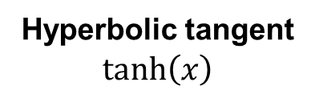
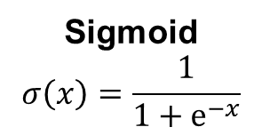
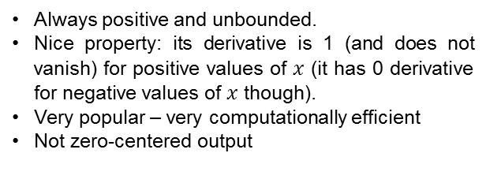
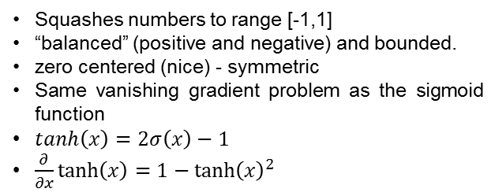
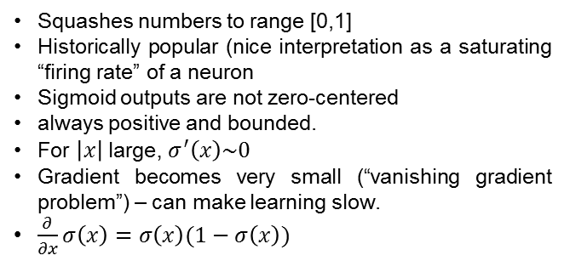
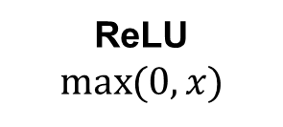
Activation Functions
The purpose of activation functions is to introduce non-linearities into the network
Squashes numbers to range [0,1]
Historically popular (nice interpretation as a saturating “firing rate” of a neuron
Sigmoid outputs are not zero-centered
always positive and bounded.
For $\left|x\right|$large, $σ^{′}\left(x\right)\sim 0$
Gradient becomes very small (“vanishing gradient problem”) – can make learning slow.
$\frac{∂}{∂x}σ\left(x\right)=σ\left(x\right)(1−σ\left(x\right))$
Sigmoid
$$σ\left(x\right)=\frac{1}{1+e^{−x}}$$
Squashes numbers to range [-1,1]
“balanced” (positive and negative) and bounded.
zero centered (nice) - symmetric
Same vanishing gradient problem as the sigmoid function
$tanh\left(x\right)=2σ\left(x\right)−1$
$\frac{∂}{∂x}tanh\left(x\right)=1−{tanh\left(x\right)}^{2}$
Hyperbolic tangent
$$tanh\left(x\right)$$
ReLU
$$\max_{}{(0,x)}$$
Always positive and unbounded.
Nice property: its derivative is 1 (and does not vanish) for positive values of $x$ (it has 0 derivative for negative values of $x$ though).
Very popular – very computationally efficient
Not zero-centered output
Notes:
Ajouter une photo d’un vieux telegraphe, puis un mobile satellitte ancienne generation…can someone find an even older wireless communication system (smoke)

Slide 27
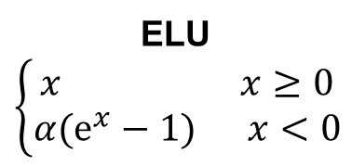
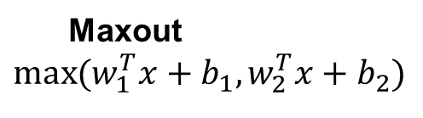
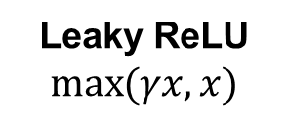
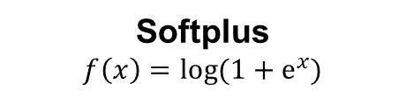
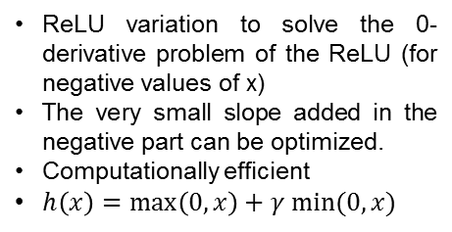
Activation Functions
ReLU variation to solve the 0-derivative problem of the ReLU (for negative values of x)
The very small slope added in the negative part can be optimized.
Computationally efficient
$h\left(x\right)=\max\left(0,x\right)+γ min⁡(0,x)$
Leaky ReLU
$$\max_{}{(γx,x)}$$
All benefits of ReLU (similar but becomes smooth slowly)
Produce negative outputs.
Closer to zero mean outputs
Negative saturation regime compared to Leaky ReLU
Longer computation time due to exponential operator
Exploding gradient problem
ELU
$$\left\{\begin{aligned}x x≥0 \\ α(e^{x}−1) x<0\end{aligned}\right.$$
Generalizes ReLU and Leaky ReLU
Linear regime, no problem with vanishing or exploding gradients.
Constants can be optimized depending on application.
But doubles the number of parameters/neuron
Softplus
$$f\left(x\right)=log{(1+e^{x})}$$
Maxout
$$\max_{}{(w_{1}^{T}x+b_{1},w_{2}^{T}x+b_{2})}$$
Notes:
Ajouter une photo d’un vieux telegraphe, puis un mobile satellitte ancienne generation…can someone find an even older wireless communication system (smoke)

Slide 28
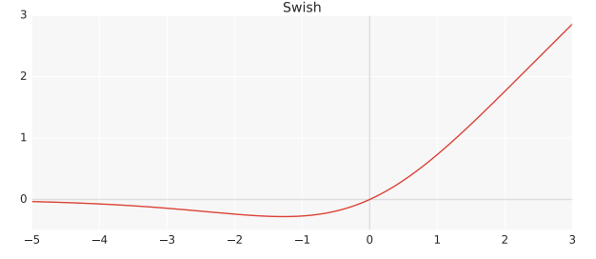
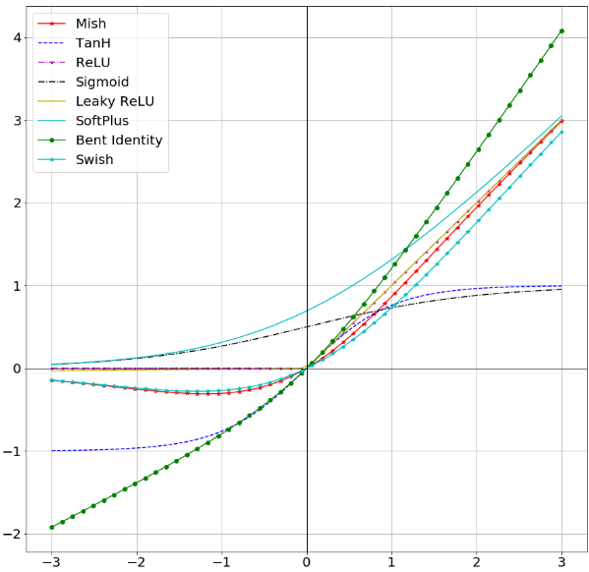
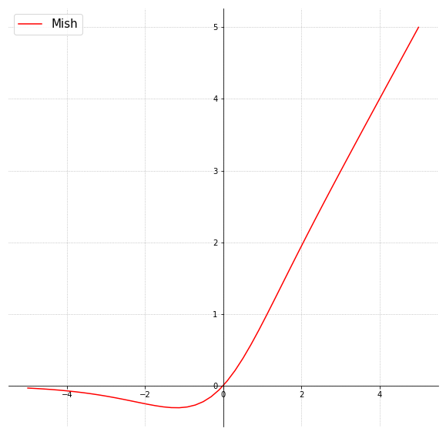
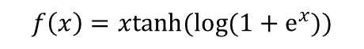
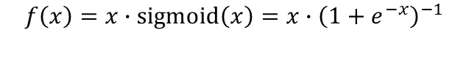
“Recent” Activation Functions
Swish (Google)
Similar to ReLU.
Bounded below: Swish benefits from sparsity similar to ReLU. Very negative weights are simply zeroed out.
Unbounded above: for very large values, the outputs do not saturate to the maximum value (i.e., to 1 for all the neurons).
$$f\left(x\right)=x∙sigmoid\left(x\right)=x∙{\left(1+e^{−x}\right)}^{−1}$$
Mish
$$f\left(x\right)=xtanh(log{(1+e^{x}))}$$
Notes:
Ajouter une photo d’un vieux telegraphe, puis un mobile satellitte ancienne generation…can someone find an even older wireless communication system (smoke)

Slide 29
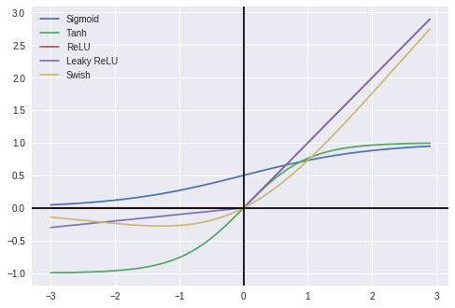

Activation Functions in a Nutshell
Source : https://towardsdatascience.com/comparison-of-activation-functions-for-deep-neural-networks-706ac4284c8a
Notes:
Ajouter une photo d’un vieux telegraphe, puis un mobile satellitte ancienne generation…can someone find an even older wireless communication system (smoke)

Slide 30


Setting the Learning Rate
Gradient Descent
$$W=W−η \frac{∂J\left(W\right)}{∂W}$$
How can we set the learning rate?
Small learning rate converges slowly and gets stuck in false local minima
Large learning rate overshoots, becomes unstable, and diverges
Stable learning rate converges smoothly and avoids local minima
The loss surfaces of ResNet-56 wo/ skip connections.
“Visualizing the loss landscape of neural nets” – NIPS 2017
Notes:
Ajouter une photo d’un vieux telegraphe, puis un mobile satellitte ancienne generation…can someone find an even older wireless communication system (smoke)

Slide 31

Setting the Learning Rate
Idea 1: Try lots of different learning rates and see what works “just right”
Idea 2: Design an adaptive learning rate that “adapts” to the landscape
Adaptive learning rates:
Intuition: increase the update strength for parameters that have had smaller
updates in the past.
No longer fixed, can be made smaller or larger depending on:
How large the gradient is
How fast training is happening
Size of particular weighs
statistics of the history of gradient updates for a parameter
etc…
GD Algorithms
SGD, Adam, Adadelta, Adagrad, RMSProp
Source: cs231n Stanford
Notes:
Ajouter une photo d’un vieux telegraphe, puis un mobile satellitte ancienne generation…can someone find an even older wireless communication system (smoke)

Slide 32
Data Preprocessing
X [N x D] data matrix
N : size of data
D : dimensionality
Mean subtraction: subtract the mean across every individual feature in the data
Geometric interpretation: centering the cloud of data around the origin along every dimension.
Normalization: normalize the data dimensions so that they are of approximately the same scale.
Two common ways:
1) divide each dimension by its standard deviation, once it
has been zero-centered
2) normalize each dimension so that the min and max
along the dimension is -1 and 1 respectively.
Makes sense if different input features have different scales (or units), but they should be of approximately equal importance to the learning algorithm.
Notes:
Ajouter une photo d’un vieux telegraphe, puis un mobile satellitte ancienne generation…can someone find an even older wireless communication system (smoke)

Slide 33
Data Preprocessing
Once centered, we compute the covariance matrix
PCA: covariance matrix becomes diagonal (decorrelates data)
Reduce the dimensionality of the data by only using the top few eigenvectors, and discarding the dimensions along which the data has no variance.
E.g., we keep the 100 dimensions of data that contains the most variance, so from a dataset of size [N x D], we pass to one of [N x 100]
Whitening: covariance matrix becomes identity
take the data in the eigenbasis and divide every dimension by the eigenvalue to normalize the scale.
Geometric interpretation: if input data is a multivariable Gaussian, whitened data will be a Gaussian with zero mean and identity covariance matrix (stretching and squeezing the data into an isotropic Gaussian blob).
Notes:
Ajouter une photo d’un vieux telegraphe, puis un mobile satellitte ancienne generation…can someone find an even older wireless communication system (smoke)

Slide 34
Data Preprocessing
Before normalization: classification loss
very sensitive to changes in weight matrix;
hard to optimize
After normalization: less sensitive to small
changes in weights; easier to optimize
Notes:
Ajouter une photo d’un vieux telegraphe, puis un mobile satellitte ancienne generation…can someone find an even older wireless communication system (smoke)

Slide 35
Weight Initialization
Unknown a priori final values of every weight
with proper data normalization: half weights positive - half negative (approximately).
First idea: all weights to zero.
Q: Is it a good idea? What happens? (think of gradients during backpropagation)
A: Hidden units are all going to compute the same function, gradients are going to be the same
Second idea: small random numbers (symmetry breaking)
e.g., weight vectors ~ multi-dimensional Gaussian with zero mean and 0.01 standard deviation.
OK for small NNs, problematic in deep NNs (activations become 0, all neurons saturated, gradients 0…).
Layer with very small weights will during backpropagation compute very small gradients on its data (since this gradient is proportional to the value of the weights).
This could greatly diminish the “gradient signal” flowing backward through a network (vanishing gradients caused by small output)
Another issue: distribution of the outputs from a randomly initialized neuron has a variance that grows with the number of inputs → normalize the variance of each neuron’s output to 1 by scaling its weight vector by the square root of its number of inputs.
Notes:
Ajouter une photo d’un vieux telegraphe, puis un mobile satellitte ancienne generation…can someone find an even older wireless communication system (smoke)

Slide 36
Weight Initialization
Third idea: big random numbers
e.g., weight vectors ~ multi-dimensional Gaussian with zero mean and 1 standard deviation.
Gradient of the activation function becomes close to 0.
Vanishing gradient, caused by saturated activation function.
Notes:
Ajouter une photo d’un vieux telegraphe, puis un mobile satellitte ancienne generation…can someone find an even older wireless communication system (smoke)

Slide 37




Weight Initialization
Scaling the variances ensures that all neurons in the network initially have approximately the same output distribution and empirically improves the rate of convergence.
Consider the inner product $s=\sum_{i}^{n}{w_{i}x_{i}}$ between the weights and the input, which gives the raw activation of a neuron before the non-linearity.
If we want s to have the same variance as all of its inputs x, during initialization the variance of each weight should be 1/n. [$Var\left(s\right)=Var(x)⇒nVar(w)Var(x)$= $Var\left(x\right)⇒Var\left(w\right)=1/n$,
Since $Var\left(aX\right)=a^{2}Var(X)$, then $a=\sqrt{1/n}$.
Similar analysis used in Xavier and He initialization
𝑛: # input neurons for the layer of weights we want to initialized
Assuming zero mean inputs and weights $𝔼\left(w_{i}\right)=𝔼\left(x_{i}\right)=0$
(not the case for ReLU)
Assuming $w_{i}$, $x_{i}$ identically distributed
Notes:
Ajouter une photo d’un vieux telegraphe, puis un mobile satellitte ancienne generation…can someone find an even older wireless communication system (smoke)

Slide 38
Weight Initialization
Initialization too small:
Activations go to zero, gradients also zero
No learning
Initialization too big:
Activations saturate (for tanh)
Gradients zero, no learning
Initialization just right:
Nice distribution of activations at all layers,
Learning proceeds nicely
Notes:
Ajouter une photo d’un vieux telegraphe, puis un mobile satellitte ancienne generation…can someone find an even older wireless communication system (smoke)

Slide 39



Batch Normalization
Explicitly force the activations throughout a network to take on a unit Gaussian distribution at the beginning of the training.
Core observation: this is possible because normalization is a simple differentiable operation.
Implementation: insert the BatchNorm layer immediately after fully connected layers and before non-linearities.
Compute the empirical mean and variance independently for each dimension
Fully Connected
Normalize: ${\hat{x}}^{(k)}=\frac{x^{(k)}−𝔼(x^{\left(k\right)})}{\sqrt{Var(x^{\left(k\right)})}}$
Batch Normalization
Then allow the network to squash the range if it wants to: $y^{(k)}$ = $γ^{(k)}{\hat{x}}^{(k)}$+$β^{(k)}$
Activation Function
The network can learn: $γ^{(k)}=\sqrt{Var(x^{\left(k\right)})}$
$β^{(k)}=𝔼(x^{\left(k\right)})$ to recover the identity mapping
Fully Connected
Allows higher learning rates
Reduces the strong dependence on initialization
Acts as a form of regularization, and slightly reduces (maybe) the need for dropout (= keep a neuron active with probability p or setting it to 0 otherwise)
Batch Normalization
Notes:
Ajouter une photo d’un vieux telegraphe, puis un mobile satellitte ancienne generation…can someone find an even older wireless communication system (smoke)

Slide 40
Batch Normalization
Notes:
Ajouter une photo d’un vieux telegraphe, puis un mobile satellitte ancienne generation…can someone find an even older wireless communication system (smoke)

Slide 41

Regularization
Technique that constrains our optimization problem to discourage complex models
It improves generalization on unseen data (avoids overfitting)
Dropout
During training, randomly set some activations to 0
Typically “drop” 50% of activations in layer
Forces network to not rely on any 1 node
Early Stopping
Stop training before we have a chance to overfit
Notes:
Ajouter une photo d’un vieux telegraphe, puis un mobile satellitte ancienne generation…can someone find an even older wireless communication system (smoke)

Slide 42

Regularization
Data Augmentation
Create “fake” data (translation, rotation, random crops, noise injection)
Bagging and Ensemble Methods
Train multiple models and average their results
Parameter Norm Penalties
Add a parameter norm penalty $Ω(θ)$to the objective function
Noise Robustness
Adding noise to the output targets or to the weights
Multi-task Learning
Jointly learning multi-tasks by sharing the same inputs and some intermediate representations, which capture a common pool of factors
Notes:
Ajouter une photo d’un vieux telegraphe, puis un mobile satellitte ancienne generation…can someone find an even older wireless communication system (smoke)

Slide 43
Deep Sequence Modeling

Slide 44

Deep Sequence Modeling
Predict the future behavior given its past states:
?

Slide 45















Applications
Many to One
One to Many
Many to Many
$$\hat{y}$$
$$NN$$
$$NN$$
$$NN$$
$$NN$$
$$NN$$
$$NN$$
$$NN$$
$$NN$$
$$NN$$
$$NN$$
$$x$$
Sentiment classification
Captioning
Translation
Classification,
Regression

Slide 46

















Recurrent Neural Network
$${\hat{y}}_{0}$$
$${\hat{y}}_{1}$$
$${\hat{y}}_{2}$$
$${\hat{y}}_{3}$$
$$h_{0}$$
$$h_{1}$$
$$h_{2}$$
$$NN$$
$$NN$$
$$NN$$
$$NN$$
$$x_{0}$$
$$x_{1}$$
$$x_{2}$$
$$x_{3}$$
Recurrence
$${\hat{y}}_{t}=f\left(x_{t}\right)$$
$${\hat{y}}_{t}=f\left(x_{t}, h_{t−1}\right)$$
past memory

Slide 47







Recurrent Neural Network
$${\hat{y}}_{t}$$
$$h_{t}=f_{W}\left(x_{t}, h_{t−1}\right)$$
Hidden state
$$h_{t}$$
$$RNN$$
$$h_{t}=f\left(W_{hh}^{T}h_{t−1}+W_{xh}^{T}x_{t}\right)$$
Update hidden state
$${\hat{y}}_{t}=W_{hy}^{T}h_{t}$$
Output
$$x_{t}$$
Hidden state $h_{t}$ is updated at each time step as the sequence is processed

Slide 48




















Loss and Backpropagation
$$L_{ }$$
Backward pass
$$L_{0}$$
$$L_{1}$$
$$L_{2}$$
$$L_{3}$$
$${\hat{y}}_{0}$$
$${\hat{y}}_{1}$$
$${\hat{y}}_{2}$$
$${\hat{y}}_{3}$$
$$h_{0}$$
$$h_{1}$$
$$h_{2}$$
$$NN$$
$$NN$$
$$NN$$
$$NN$$
$$x_{0}$$
$$x_{1}$$
$$x_{2}$$
$$x_{3}$$

Slide 49





















Loss and Backpropagation
Issues:
Exploding gradients ($∇ >1)$:
Solution: Gradient clipping
Vanishing gradients ($∇<1)$:
Solution:
Activation function
Weight initialization
…
For instance, the gradient for $h_{0}$
Involves many factors $\left(W_{hh}\right)$
$$L_{ }$$
Backward pass
$$L_{0}$$
$$L_{1}$$
$$L_{2}$$
$$L_{3}$$
$${\hat{y}}_{0}$$
$${\hat{y}}_{1}$$
$${\hat{y}}_{2}$$
$${\hat{y}}_{3}$$
$$h_{0}$$
$$h_{1}$$
$$h_{2}$$
$$NN$$
$$NN$$
$$NN$$
$$NN$$
$$x_{0}$$
$$x_{1}$$
$$x_{2}$$
$$x_{3}$$

Slide 50

Long Short Term Memory (LSTM)
Key concepts:
Cell state
Usage of gates for information flow control:
Forget irrelevant information
Store relevant information from current input
Update cell state
Output a filtered version of the cell state
Partially uninterrupted gradient flow

Slide 51











Limitations of RNN
Limitations:
Encoding bottleneck
Lack of parallelizability
Short term (not long) memory
Linear order of inputs
$${\hat{y}}_{0}$$
$${\hat{y}}_{1}$$
$${\hat{y}}_{2}$$
$${\hat{y}}_{3}$$
$$h_{0}$$
$$h_{1}$$
$$h_{2}$$
$$NN$$
$$NN$$
$$NN$$
$$NN$$
$$x_{0}$$
$$x_{1}$$
$$x_{2}$$
$$x_{3}$$

Slide 52


Transformers

Slide 53


Attention
Attention is weighted averaging
Hard search
(search in a lookup table)
Soft search
*Attention can be very powerful if the weights are learned!
Notes:
Given a set of vector values, and a vector query, attention is a technique to compute a weighted sum of the values, dependent on the query.

Slide 54

Self-Attention (Example)
Attention value for “lunch”:
I went to the restaurant to eat lunch
Notes:
RNN is used to pass information. For this we need self-attention to know more about our information

Slide 55


Self-Attention
keys, queries, values from the same sequence:
Let $w_{i}$be a sequence of inputs in vocabulary $V$.
For each $w_{i}$ , let $x_{i}=Ew_{i}$, where $E∈R^{d×\left|V\right|}$ is an embedding matrix.
1. Transform each input embedding with weight matrices $Q, K, V∈R^{d×d}$
$q_{i}=Q x_{i}$ (queries) $k_{i}=K x_{i}$ (keys) $v_{i}=V x_{i}$ (values)
2. Compute pairwise similarities between keys and queries; normalize with softmax
$e_{ij}=q_{i}^{T}k_{j}$ $α_{ij}=\frac{\exp\left(e_{ij}\right)}{\sum_{j′}{\exp\left(e_{ij′}\right)}}$
3. Compute output for each input as weighted sum of values
$o_{i}=\sum_{j}{a_{ij}v_{i}}$

Slide 56





Self-Attention
Issues:
No notion of order
No nonlinearities
Non-causality
we need to ensure we can’t peek at the future for prediction
(Masking)
Add position representations to the inputs
Add a feed-forward network to post-process each output vector
(i.e. MLP)
I
went
to
$${\tilde{x}}_{i}=x_{i}+p_{i}$$
MLP
 | $$−∞$$ | $$−∞$$
 |  | $$−∞$$
$p_{i}∈R^{d}$
(position vectors)
Usually to be learned
I
Self-attention
went
MLP
to
Self-attention
$$e_{ij}=\left\{\begin{aligned}q_{i}^{T}k_{j}; j≤i \\ −∞; \text{else}\end{aligned}\right.$$
$$x_{i}$$

Slide 57







What else?
Some tricks
Multi-headed attention
Residual connections
Layer normalization
$$X\left(i\right)$$
What if we want to look in multiple places in the input at once
$$output= \frac{x−μ}{\sqrt{σ^{2}+ε}}γ+β$$
$$Q_{k}, K_{k}, V_{k}∈R^{d×\frac{d}{h}}, k∈[1, h]$$
$μ$: mean over $x$
computationally efficient
$σ^{2}$: variance over $x$
help models train faster
$$X\left(i−1\right)$$
Good for gradient vanishing

Slide 58

Transformer Decoder
Stack of Transformer Decoder Blocks:
Self-attention
Add & Norm
Feed-Forward
Add & Norm

Slide 59

Transformer Encoder
Stack of Transformer Encoder Blocks:
Self-attention
Add & Norm
Feed-Forward
Add & Norm
Without masking

Slide 60




Transformer Encoder-Decoder
Stack of Encoder and Decoder Blocks:
Self-attention
Add & Norm
Feed-Forward
Add & Norm
Cross-attention
Keys and Values from Encoder
$k_{i}=Kh_{i}, v_{i}=Vh_{i}$
Queries from Decoder
$q_{i}=Qz_{i}$
$$h_{i}$$
$$z_{i}$$

Slide 61
Large Language Models
Encoder
(BERT)
Decoder
(GPT)
Encoder-Decoder
(T5)
Notes:
GPT: Generative Pre-trained Transformer
BERT: Bidirectional Encoder Representations from Transformers
T5: Text-to-Text Transfer Transformer

Slide 62

Model size vs. Dataset size
This works better!!!
Cost of training: Size * Tokens

Slide 63

Beyond Language
Vision Transformer
Idea:
Tokenize the image by cutting it into patches of 16x16, and treat each patch as a token.
An Image is Worth 16x16 Words: Transformers for Image Recognition at Scale
A. Dosovitskiy, et al. 2020.

Slide 64



Recap
Fully connected networks
Recurrent Neural networks
Transformers
Convolutional neural networks
Auto Encoders (AE)
Bayesian Neural networks
RNN
AE

Slide 65
Neural Network Limitations
Very data hungry (e.g. often millions of examples)
Computationally intensive to train and deploy (tractably requires GPUs)
Easily fooled by adversarial examples
Uninterpretable black boxes, difficult to trust
Finicky to optimize: non-convex, choice of architecture, learning parameters
Often require expert knowledge to design, fine tune architectures
Notes:
Ajouter une photo d’un vieux telegraphe, puis un mobile satellitte ancienne generation…can someone find an even older wireless communication system (smoke)

Slide 66
Deep Learning
(Hierarchical) Compositionality
Cascade of non-linear transformations
Multiple layers of representations
End-to-End Learning
Learning (goal-driven) representations
Learning to feature extract
Distributed Representations
Localist representation: dedicate one neuron to each thing.
Distributed representation means a many-to-many relationship between two types of representation (such as concepts and neurons).
Each concept is represented by many neurons
Each neuron participates in the representation of many concepts
No single neuron “encodes”
Notes:
Ajouter une photo d’un vieux telegraphe, puis un mobile satellitte ancienne generation…can someone find an even older wireless communication system (smoke)

